Slide 1


Intelligent Conversational AI Chatbot with Domain
Knowledge Integration for Healthcare
CSA1710-Artificial Intelligence
A Safe, Context-Aware Conversational Assistant for Reliable Healthcare Information
Presented By: G.Pallavi(192311208) P Harshitha(192312506) Shakthi(192312538)
Guided By: Dr. B Nagarajan
1

Slide 2
Introduction
Healthcare information is often difficult for patients to access and understand.
Users commonly search online for symptoms, medicines, diseases, and general health information.
Conventional chatbots may provide generic responses without sufficient healthcare knowledge.
Generative AI can understand natural-language questions and provide conversational responses.
The proposed system integrates AI with healthcare domain knowledge to provide reliable and context-aware assistance.
The chatbot acts as an intelligent first-level information assistant.
2

Slide 3
Problem Statement
Patients may struggle to obtain quick and understandable healthcare information.
General-purpose chatbots may provide irrelevant or inaccurate responses.
Medical terminology can be difficult for non-technical users to understand.
Traditional healthcare information systems generally depend on keyword-based searches.
There is a need for a conversational system that can:
Understand natural-language healthcare queries.
Retrieve relevant domain knowledge.
Generate meaningful responses.
Maintain conversational context.
Provide safe and responsible healthcare information.
3

Slide 4
Objectives
Develop an intelligent conversational healthcare chatbot.
Integrate healthcare-specific knowledge into the chatbot.
Understand and process natural-language user queries.
Retrieve relevant healthcare information from the knowledge base.
Generate context-aware and easy-to-understand responses.
Maintain conversation history for better interaction.
Provide safety-aware responses and recommend professional consultation when required.
4

Slide 5
Literature Survey
Author / Year | Title / Source | Key Contribution | Relevance to Project | Limitations / Gap
Smith et al., 2021 | A Survey of Medical Chatbot Systems | Reviewed rule-based vs ML-based healthcare bots | Baseline architecture comparison | Limited handling of multi-turn context
Kumar et al., 2022 | BERT-Based Intent Classification for Healthcare Queries | Fine-tuned BERT for symptom intent detection | Informs the query understanding module | Needs large labeled medical datasets
Chen et al., 2022 | Knowledge-Grounded Response Generation in Medical Dialogue | Combined KB retrieval with generation models | Basis for knowledge-integrated response design | Risk of factual drift without validation
Patel & Rao, 2023 | Evaluating LLM Hallucination in Clinical QA | Identified hallucination risks in generative healthcare answers | Motivates confidence & safety validation module | No standardized safety-scoring method proposed
Gupta et al., 2023 | Context-Aware Conversational Agents for Patient Support | Proposed a context-tracking dialogue manager | Informs context-aware response generation | Struggles with domain-specific vocabulary
5
Notes:
Most existing chatbots rely on either scripted rules or generic LLMs, lacking verified medical grounding.
Context retention across multi-turn healthcare conversations remains weak in current systems.
Few systems include a dedicated confidence or safety-validation layer before delivering responses.
Domain-specific knowledge bases are rarely integrated directly into the response-generation pipeline.
Personalization based on user history and prior interactions is largely unexplored.
These gaps motivate a unified, safety-aware, knowledge-integrated conversational framework.

Slide 6
Modules
Module 1: Healthcare Knowledge Integration
Module 2: Conversational AI & Query Processing
Module 3: Intelligent Response & Healthcare Assistance
9

Slide 7

MODULE 1
Healthcare Knowledge Integration
10

Slide 8
Module 1: Objective & Knowledge Collection
Objective
To provide the chatbot with reliable healthcare domain knowledge for answering user queries.
Functions
Collect healthcare-related information.
Clean and preprocess the information.
Organize information into a structured knowledge base.
Retrieve relevant information based on user queries.
Provide domain-specific context to the AI model.
Technologies
Python
NLP
Database / Knowledge Base
Embedding-based retrieval
11

Slide 9
Module 1: Preprocessing, Retrieval & Output
→ Collect healthcare domain documents/data → Clean and preprocess the data → Split information into meaningful sections → Convert knowledge into searchable representations → Store knowledge in the database/vector store → Receive user query → Search for relevant healthcare information → Return the most relevant knowledge → Send retrieved information to Module 2
12

Slide 10

MODULE 2
Conversational AI & Query Processing
13

Slide 11
Module 2: Understanding the User Query
Objective
To understand the user's healthcare query and determine the appropriate information required to generate a response.
Functions
Accept natural-language questions.
Identify user intent.
Extract important medical entities or keywords.
Analyze conversational context.
Retrieve relevant knowledge.
Pass processed information to the response-generation module.
Technologies
NLP
LLM / Generative AI
Python
Text processing techniques
14

Slide 12
Module 2: Response Generation & Validation
→ Receive user message → Preprocess the query → Identify intent → Extract important entities / keywords → Analyze previous conversation context → Generate search query → Retrieve relevant healthcare knowledge → Combine query + context + retrieved knowledge → Send information to Module 3
15

Slide 13

MODULE 3
Intelligent Response & Healthcare Assistance
16

Slide 14
Module 3: Generating Healthcare Responses
Objective
To generate clear, relevant, context-aware, and safety-conscious responses using the processed query and retrieved healthcare knowledge.
Functions
Combine user query with retrieved knowledge.
Generate natural-language responses.
Maintain conversational context.
Simplify complex medical terminology.
Detect potentially high-risk queries.
Recommend professional medical consultation when appropriate.
17

Slide 15
Module 3: Safety, History & Output
→ Receive processed query → Receive retrieved healthcare knowledge → Add conversation context → Generate response using AI model → Check response relevance → Apply healthcare safety rules → If high-risk situation detected → Recommend professional medical help → Otherwise → Return response → Store conversation context
18

Slide 16
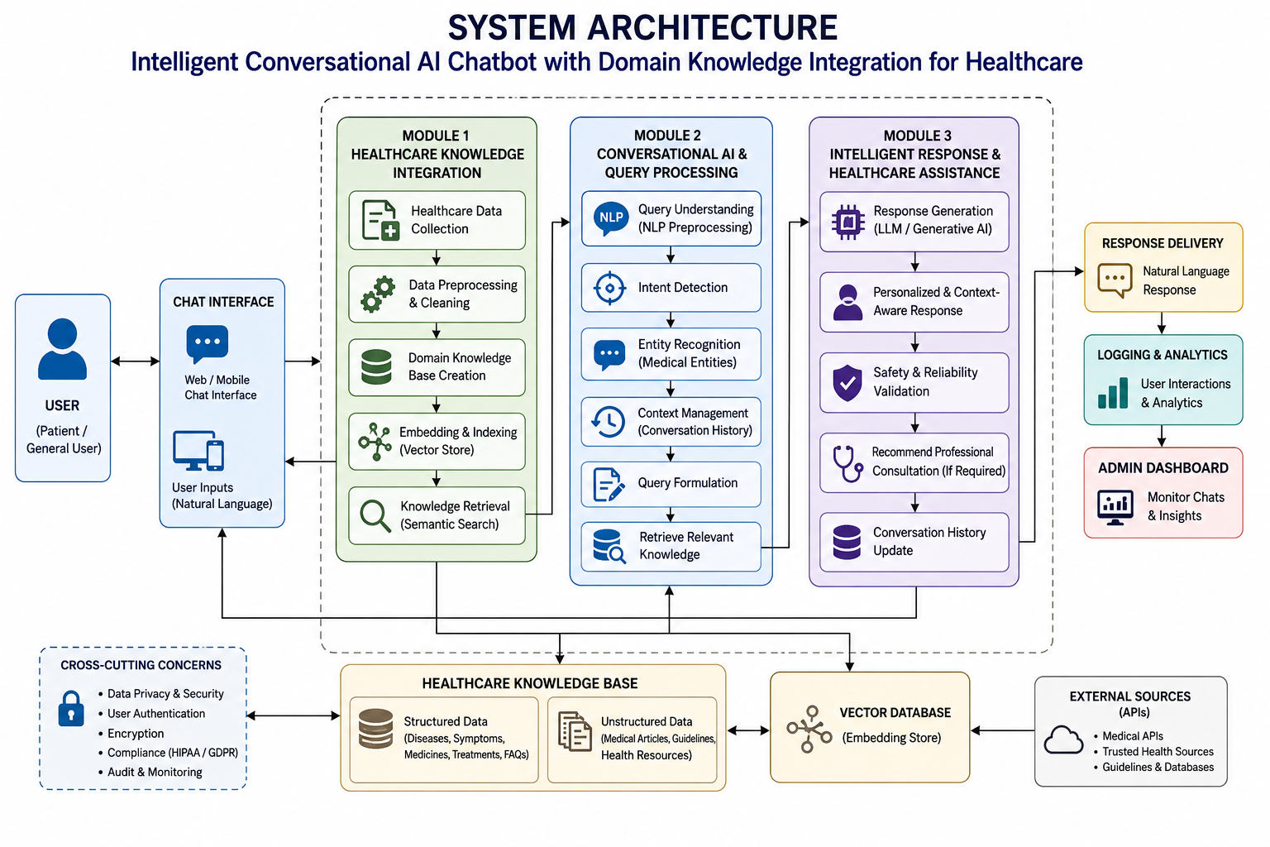
System Architecture / Workflow
8
Notes:
RAG (Retrieval-Augmented Generation) -retrieves relevant healthcare information before generating an answer.
User → Chat Interface: The user enters a healthcare question through the chatbot.
Module 2 – Query Processing: The system understands the question using NLP, identifies the intent and medical entities, and checks previous conversation context.
Module 1 – Healthcare Knowledge Integration: The system searches the healthcare knowledge base using embeddings and a vector database and retrieves the most relevant information.
Module 3 – Intelligent Response Generation: The retrieved information, user query, and conversation context are provided to the LLM. The LLM generates a natural-language response.
Safety Validation: The response is checked before being shown to the user. The chatbot should provide healthcare information, not claim to diagnose or replace a healthcare professional.

Slide 17





Technologies & Tools Used
Python
Core language for chatbot logic, NLP pipelines, and backend integration.
NLP
Text processing, tokenization, and intent & entity extraction using spaCy / Transformers.
LLM / Generative AI
Powers context-aware, natural-language response generation grounded in retrieved knowledge.
Knowledge Base / Database
Stores structured medical knowledge and supports fast semantic retrieval.
Web / Mobile Interface
Delivers the chatbot experience to users across web and mobile platforms.
19

Slide 18

Sample Chatbot Conversations
I've had a headache and mild fever since yesterday.
These can be common symptoms of a viral infection. Stay hydrated and monitor your temperature. If fever exceeds 102°F or persists beyond 3 days, please consult a doctor.
What is the recommended dosage of paracetamol for adults?
The typical adult dose is 500–1000mg every 4–6 hours, not exceeding 4g/day. Please confirm with a pharmacist or physician for your specific case.
22

Slide 19

Future Enhancements
Expand the knowledge base to cover more specialties and regional health guidelines.
Integrate multilingual support for wider accessibility.
Add voice-based interaction for hands-free use.
Connect with wearable/health-tracking data for more personalized responses.
Introduce human-in-the-loop escalation for high-risk queries.
25

Slide 20
Conclusion
The proposed system combines Conversational AI with healthcare domain knowledge.
It understands natural-language healthcare queries and retrieves relevant information.
The system generates context-aware and user-friendly responses.
Knowledge retrieval improves the relevance of AI-generated answers.
Safety validation helps prevent inappropriate medical recommendations.
The system can serve as an intelligent healthcare information assistant, while professional medical consultation remains necessary for diagnosis and treatment.
26
Notes:
“Our project is an intelligent conversational AI chatbot designed specifically for healthcare. Unlike a general chatbot, our system integrates a healthcare domain knowledge base with a Large Language Model using Retrieval-Augmented Generation. When a user enters a healthcare query, the system first processes the query using NLP to identify the intent, medical entities, and conversational context. It then retrieves relevant information from the healthcare knowledge base using semantic search and a vector database. The retrieved information is combined with the user's query and conversation history and provided to the LLM, which generates a natural-language response. A safety validation layer checks the response before displaying it to the user. The system is intended to provide healthcare information and assistance, not to replace professional medical diagnosis or treatment.”

Slide 21
THANK YOU
28

